Slide 1
Module 3
Building AI Agents with AutoGen

Slide 2
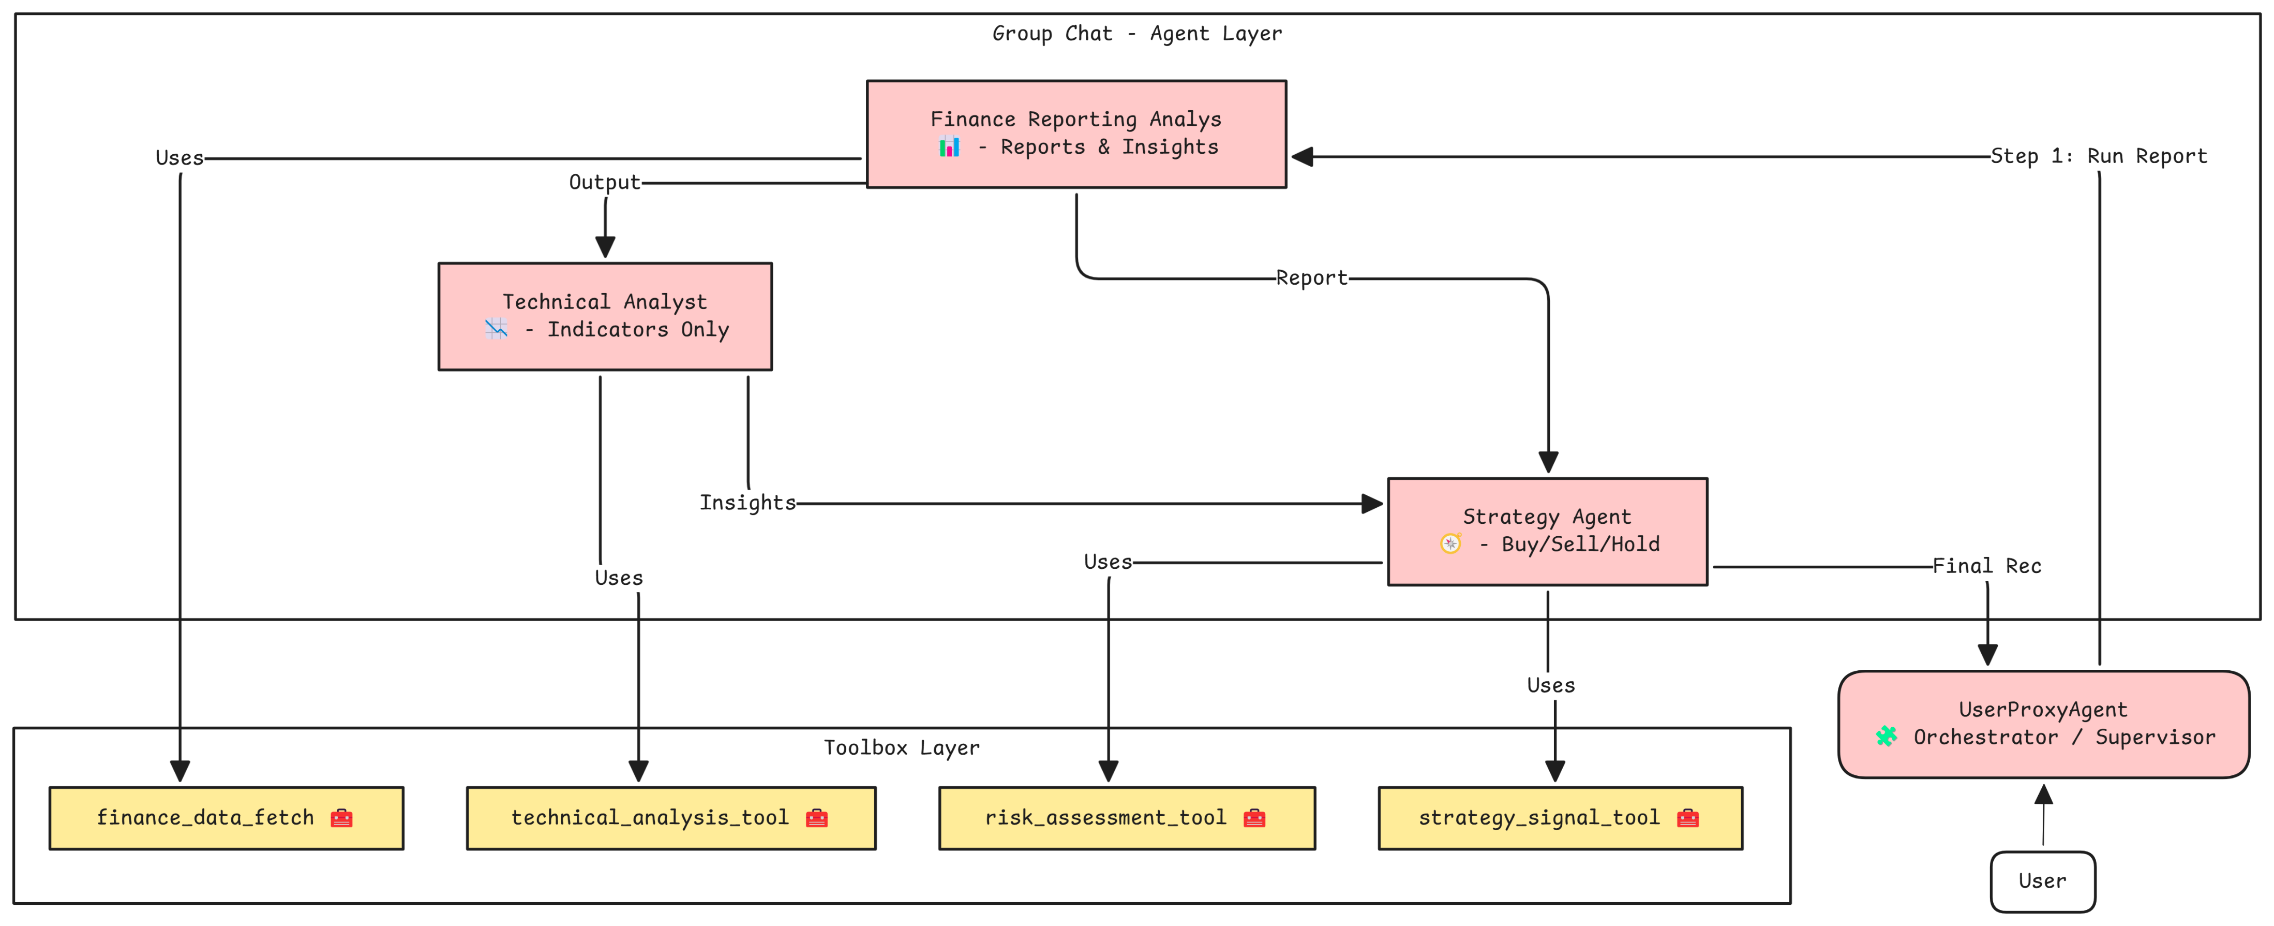
Agents and Tools for Financial Analysis

Slide 3
Agent 3 – Strategy Agent
Role: Recommend Buy/Sell/Hold actions and assess risk
Responsibilities:
Analyze trading signals: MACD, RSI, Last Close
Evaluate risk: Volatility, Beta, Dividend Yield
Provide rationale behind recommendation
Decision Logic:
Buy if MACD > Signal and RSI < 70
Sell if MACD < Signal or RSI > 70
Hold if indicators are conflicting
Tools: risk_assessment_tool, strategy_signal_tool

Slide 4
Tool 3: risk_assessment_tool
Purpose: Analyze the stock’s risk profile
Metrics Extracted:
Beta (volatility)
Market Cap
Dividend Yield
52-week Change (Volatility proxy)
Risk Rating (High / Moderate / Low)
Used by: strategy_agent for risk-informed recommendations
Error Handling: Graceful fallback with error message in JSON
{
"name": "risk_assessment_tool",
"data": {
"Beta": 1.15,
"MarketCap": 3000000000000,
"DividendYield": 0.005,
"Volatility": 0.18,
"RiskRating": "Moderate"
}
}
Notes:
When to Plan Agent Roles:
Before coding orchestration logic
When multiple skills/tools are involved
When output requires sequential reasoning or aggregation
During architecture design of multi-agent systems

Slide 5
Tool 4:strategy_signal_tool
Purpose: Buy/Sell Signals - Support decision-making
Indicators Used:
MACD (Momentum)
MACD Signal Line
RSI
Last close price
Used by: strategy_agent for buy/sell/hold recommendations
Error Handling: Graceful fallback with error message in JSON
{
"name": "strategy_signal_tool",
"data": {
"MACD": 1.43,
"MACD_Signal": 1.12,
"RSI": 63.5,
"Last_Close": 192.32
}
}
Notes:
When to Plan Agent Roles:
Before coding orchestration logic
When multiple skills/tools are involved
When output requires sequential reasoning or aggregation
During architecture design of multi-agent systems

